Slide 1
Arrays
Array: Sequence of values of the same type
Construct array:
Store in variable of type double[ ]
new double[10]
double[] data = new double[10];
Continued…

Slide 2
Arrays
When array is created, all values are initialized depending on array type:
  Numbers: 0
  Boolean: false
  Object References: null

Slide 3
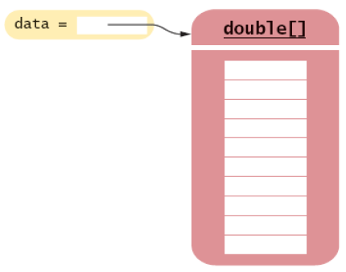
Arrays
Figure 1:
An Array Reference and an Array

Slide 4
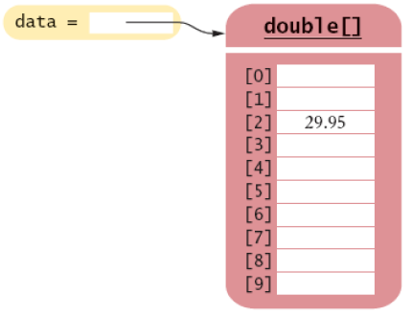
Arrays
Use [ ] to access an element
data[2] = 29.95;
Figure 2:
Storing a Value in an Array

Slide 5
Arrays
Using the value stored:
Get array length as data.length. (Not a method!)
Index values range from 0 to length - 1
System.out.println("The value of this data item is " + data[4]);
Continued…

Slide 6
Arrays
Accessing a nonexistent element results in a bounds error
Limitation: Arrays have fixed length
double[] data = new double[10];
data[10] = 29.95; // ERROR

Slide 7
The foreach Loop
Traverses all elements of a collection:
double[] data = . . .;
double sum = 0;
for (double e : data) //"for each double e in data"
{
sum = sum + e;
}
Continued…

Slide 8
The foreach Loop
Traditional alternative:
double[] data = . . .;
double sum = 0;
for (int i = 0; i < data.length; i++)
{
double e = data[i];
sum = sum + e;
}

Slide 9
foreach Limitations
The variable used to hold data in a foreach loop is a temporary variable local to the loop
Notice that you do not have access to the array index of e. This means that you have no good way to change the array.
In fact, changing data from within the loop will often have unpredictable results (runtime exceptions)
for (double e : data)
{
sum = sum + e; // scope of variable e is in here
}

Slide 10
Self Check
Write a "for each" loop that prints all ints in the array data
Why is the "for each" loop not an appropriate shortcut for the following ordinary for loop?
for (int i = 0; i < data.length; i++) data[i] = i * i;

Slide 11
Answers
The loop writes a value into data[i]. The
"for each" loop does not have the index variable i.
for (int x : data) System.out.println(x);

